Slide 1

Riding Mechanic: An iOS App for Vehicle Monitoring and Analysis
Student Name: Dezheng Wang
Faculty Advisor: Dr. Elliott Forbes

Slide 2
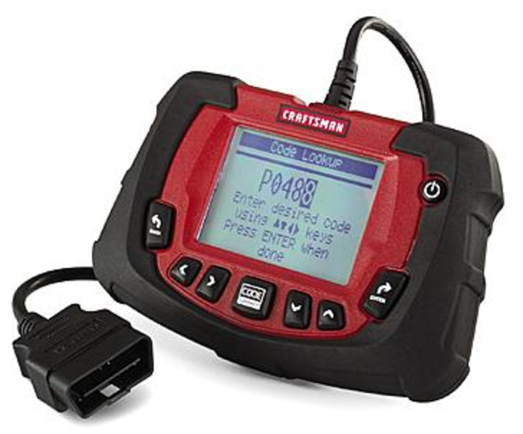
Introduction
Difficult to imagine life without driving.
On-Board Diagnostic (OBD) applications
Disadvantages of OBD applications in the market
Advantages of Riding Mechanic
© 2017 Sears Brands, LLC. All Rights Reserved
Notes:
Actually, it is possible to use an On-board Diagnostic application along with an On-board Diagnostic scanner to have access to the status of vehicle subsystems.
On-board Diagnostics (OBD) is a vehicle-mounted system used to monitor running status of engine components and working status of the emission control system.
On-board Diagnostic scanner is a scan tool which help to read data from a vehicle.
Most On-Board Diagnostic (OBD) applications in the market can provides drivers with vehicles’ real-time information and Diagnostic trouble codes.
Some early developed OBD applications did not make it very clear what problems were confronted with because

Slide 3
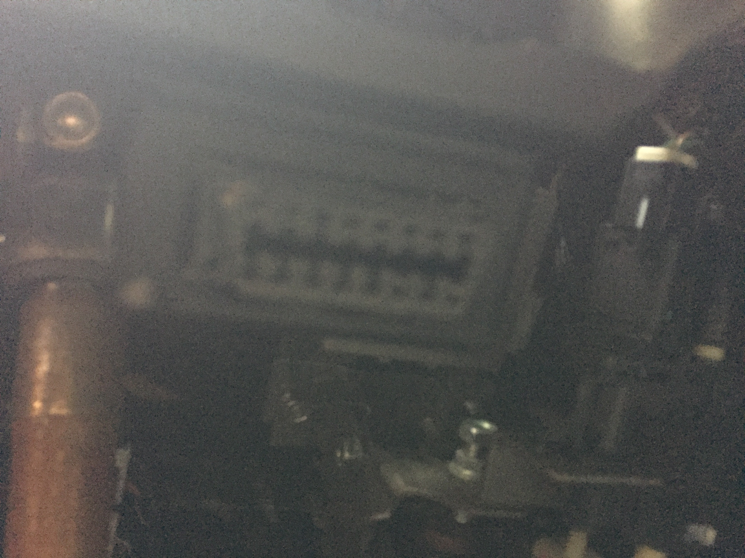
On-Board Diagnostic Systems (OBD)
Purpose of designing OBD
OBD-II
Unique features of OBD-II
An OBD port in a car
Notes:
Early OBD systems were developed to remind drivers of losing control and occurring malfunctions. As time went by, OBD-II, an advanced version over early OBD models, was adopted mandatory for all cars and light trucks manufactured in the United States since 1996. Since that time, OBD systems could monitor emission control system and began to play an important role in fighting emissions and engine failures. If any engine-related systems are broken, “Check Engine Light” or “Malfunction Indicator Lamp” will light on the dashboard of the car. Meanwhile, OBD systems will store Diagnostic Trouble Codes(DTCs) which are related to those broken systems. By using a standard scan tool, an automotive technician can quickly know what the trouble is and where it occurs. This can save plenty of time for both drivers and technicians.
The first one is that OBD-II defines universal Diagnostic Trouble Codes(DTCs) which can be used by all cars and light trucks. The second one is that all data link connectors(DLC) in cars are standard 16-Pin OBD-II ports. So, people do not need to worry about that OBD-II systems have different OBD-II ports. The last one is that OBD-II ports can help to transmit data between cars and scan tools. This allow people to plug an OBD-II scanner into an OBD-II port to have access to the cars. How the scanner works in the process of getting access from a vehicle?

Slide 4
OBD-II Scanner
How an OBD-II scanner works
Wi-Fi scanner and Bluetooth scanner
Reasons for choosing Wi-Fi scanner
Notes:
An OBD-II scanner doesn’t make any sense when it is used as an single object. In the other word, it should always work with an OBD-II port. After the OBD-II scanner plugged in an OBD-II port, it begins to act as a special server.
There are two types of OBD-II scanners so that a server usually has two types. The first type is Wi-Fi server which can provide its own Wi-Fi signals. The other one is Bluetooth which can provide its own Bluetooth signals. Connection between a mobile device and an OBD-II scanner can be built easily by connecting to that scanner’s Wi-Fi or Bluetooth. After building connections successfully, users can use an OBD-II applications to connect to the cars.
This application used an OBD-II Wi-Fi scanner. The reason is that users cannot connect to a vehicle’s Bluetooth and a scanner’s Bluetooth at the same time. Some people usually connect to the vehicle’s Bluetooth to listen to music or make phone calls. Bluetooth based applications will bring them troubles. Therefore, my choice is using an OBD-II Wi-Fi scanner.

Slide 5
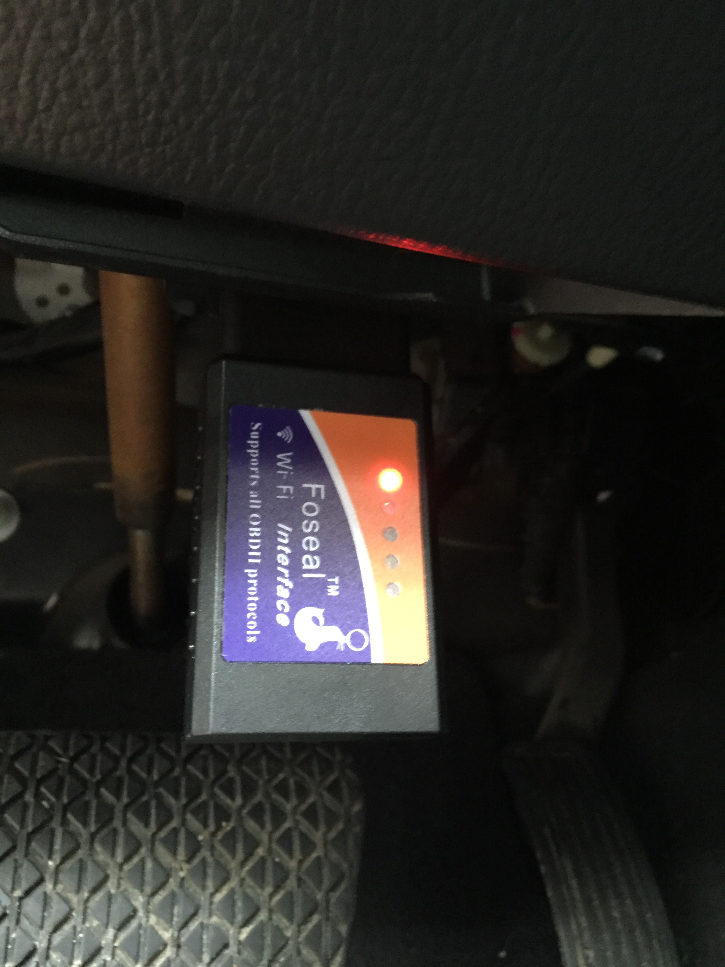
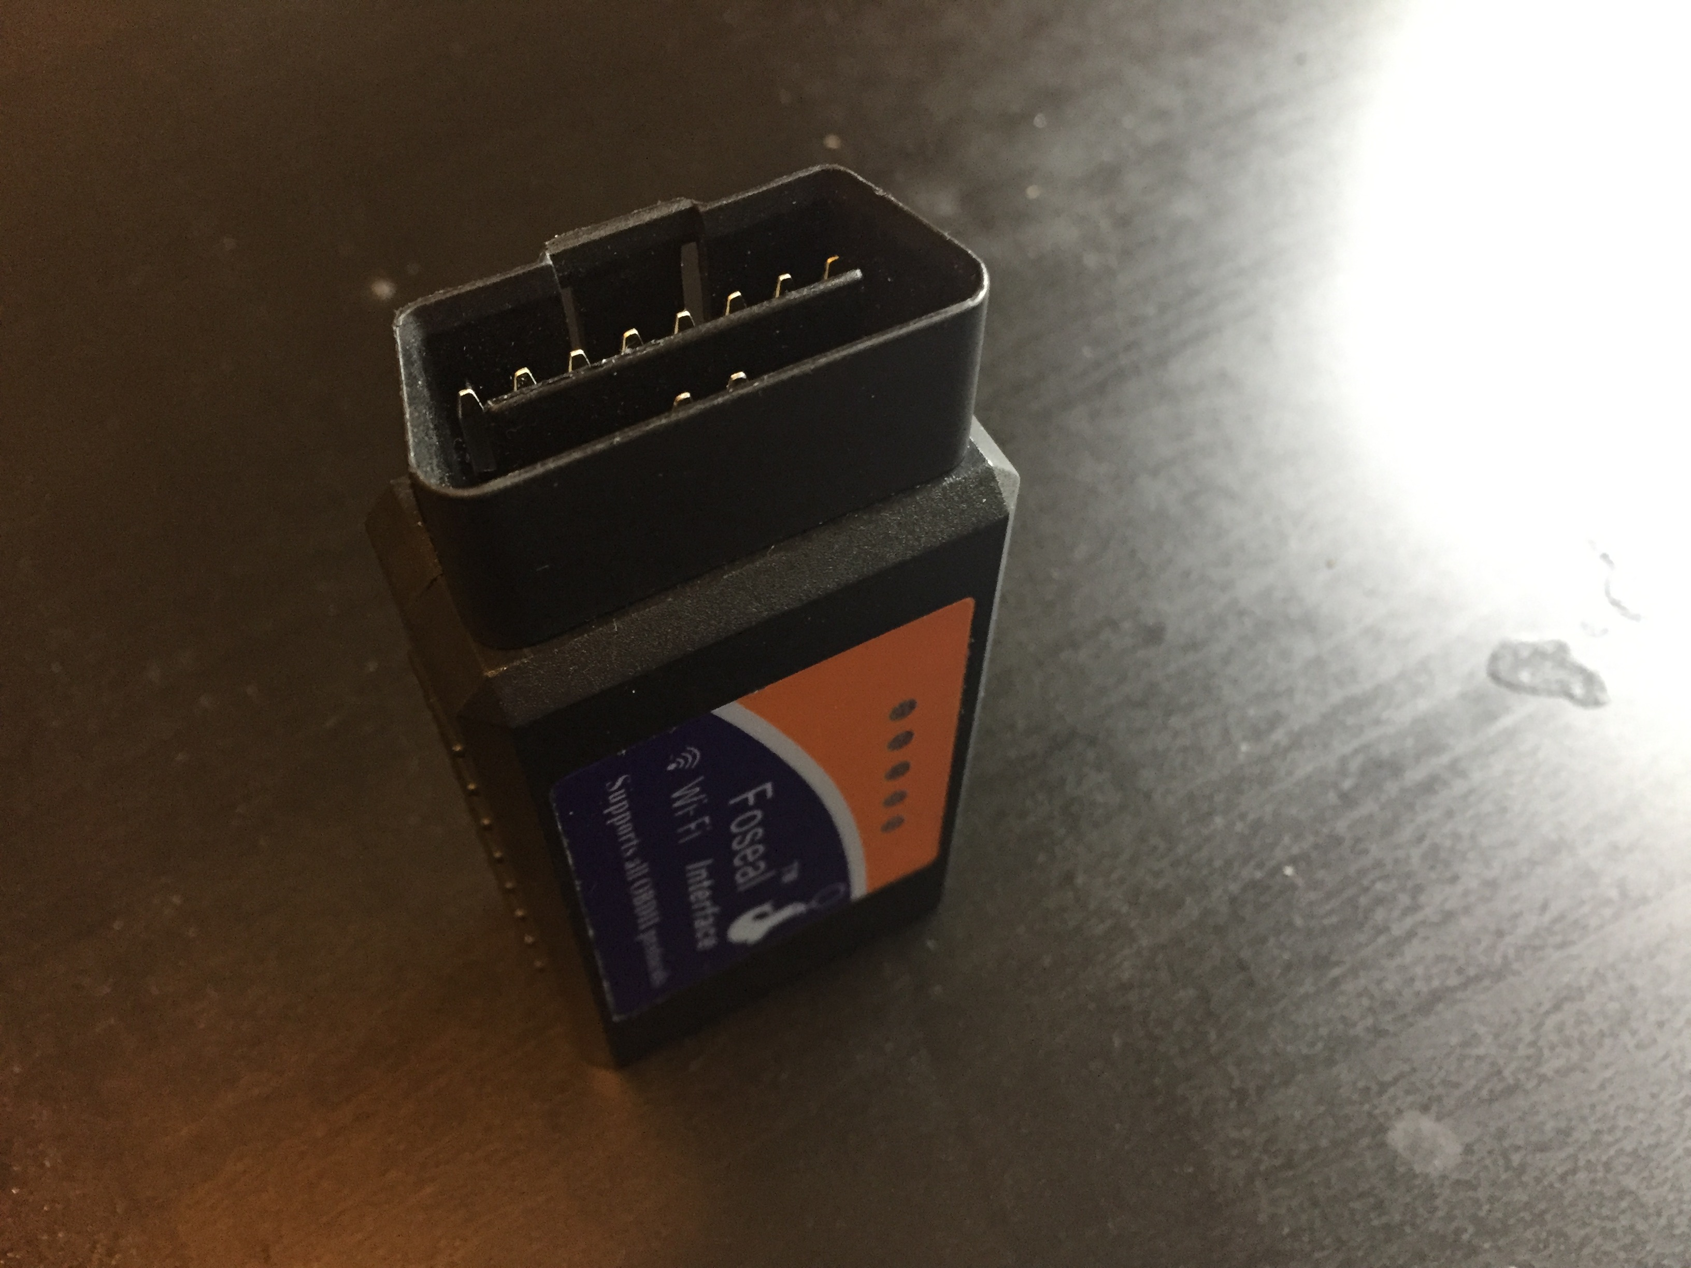
OBD-II Wi-Fi Scanner

Slide 6
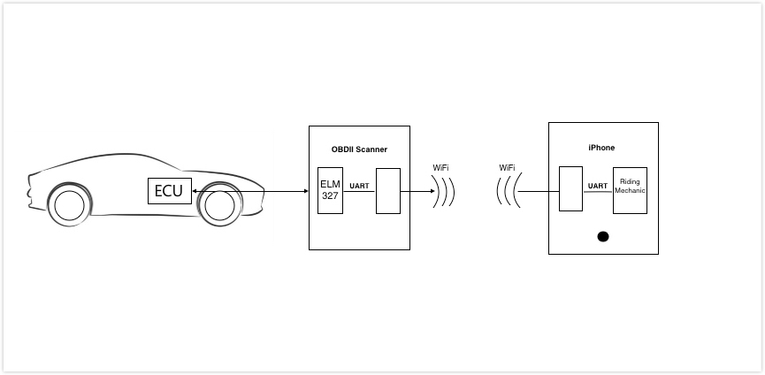
Process of Reading data
© Freelancer Technology Pty Limited
Notes:
As shown in the picture, the OBD-II Wi-Fi scanner has two components-one is ELM327 and another is a kind of Wi-Fi module which can send and receive Wi-Fi signals. ELM327 is a programmed microcontroller produced by ELM Electronics for translating the OBD interface. So, it almost supports all standard OBD-II protocols and it has a universal serial interface.
After the scanner plugged in, it will keep sending Wi-Fi signals. A mobile device also has a Wi-Fi module which can receive those Wi-Fi signals. Once connection has been built, the application starts sending commands to the Wi-Fi module on the phone through Universal Asynchronous Receiver/Transmitter (UART).
The Wi-Fi module on the phone receives those commands and sends them to the Wi-Fi module on the scanner by using wireless communication transfer protocol (WCTP). Then Wi-Fi module on the scanner receives those commands and sends them to the ELM327 through UART. Then the ELM327 uses those commands to interact with OBD-II system in the car through the universal serial interface.
The OBD-II system can quickly identify those commands and send responses to the scanner. As soon as the scanner receives responses from the car, it will send them to the application by using the same mechanism. The application will keep receiving messages. Once received, it begins to analyze those messages and transfer them into universal data used in our daily life.

Slide 7
Onboard Diagnostic Parameter IDs
OBD-II PIDs
Ten modes
PIDs used in this project
Mode (hex) | Description
01 | Show current data
03 | Show stored Diagnostic Trouble Codes
© Wikipedia
Notes:
As I mentioned in last slide, the application will send commands to the OBD-II system. Those commands are Onboard Diagnostic Parameter IDs. Onboard Diagnostic II Parameter IDs (OBD-II PIDs) are hexadecimal codes sent to a vehicle’s OBD system to request data. SAE J1979 defined standard standard OBD-II PIDs that were used by many car manufacturers, but car manufacturers also defined specific PIDs for their vehicles. This application will focus on those universal PIDs instead of all OBD-II PIDs because it is hard for developers to collect self-defined PIDs from manufacturers.

Slide 8
PIDs Used in Project
OBD-II PIDs | Description
0100 | Get supported PIDs [01-20]
0120 | Get supported PIDs [21-40]
0140 | Get supported PIDs [41-60]
0105 | Get engine coolant temperature
010C | Get engine RPM
010D | Get vehicle speed
0110 | Get MAF air flow rate
0142 | Get control module voltage
© Wikipedia

Slide 9
Diagnostic Trouble Code (DTCs)
Consist of five characters
Each letter’s meaning
DTCs in this project
Letter | System
P | Powertrain (Includes engine, transmission, drive shafts, differential and the Final Drive)
U | User Network (Wiring Bus or UART)
B | Body (Includes A/C and Air Bag)
C | Chassis (Includes ABS)
© Wikipedia
Notes:
DTCs are fault codes detected by the OBD-II systems and those trouble codes will be stored by the OBD-II system. OBD-II DTCs are alphanumeric codes which are consist of five characters, one letter followed by four digits (e.g., P1000). The first character always describes which system has that fault. The second character is usually a binary number that indicates whether the trouble code is an OBD-II generic code or not. If the second digit is zero, it is a generic code. If the second digit is one, it is a manufacturer specific code. The third character points out which subsystem has that fault. The fourth and fifth characters work together and explain that fault.
Let’s use an example of C0300.The first letter C indicates a chassis problem. The zero indicates that it is a generic code. The number three indicates that the failure is in the misfire monitoring system. The last two digits indicate that it is a rear prop shaft circuit malfunction.
This project had used over 6000 DTCs. It almost covers all generic trouble codes.

Slide 10
AT Command Set
Hayes command set
Compared to OBD-II commands
AT commands used in this project
Version | Command | Description | Group
1.0 | @1 | Display the device description | General
1.3 | @2 | Display the device identifier | General
1.3 | SP 00 | Set protocol to auto and save it | OBD
1.0 | Z | Reset all | General
© ELM Electronic Inc.
Notes:
It is a commonly used command language with a series of short text strings which can be used to manage modems’ behaviors. Although AT commands and OBD-II PIDs are both commands sent from the application, they are totally different. The application uses AT commands to change settings of the OBD-II scanner. As mentioned above, EML 327 is the core part of an OBD-II scanner. It is a kind of modem and it is fully configurable with AT commands.
An AT command is firstly created by the application and then it is transferred from the phone to the scanner by using UART and WTCP. Once the scanner has received that AT command, it can tell it and know what to do next. It will also give a response to the sender to let it know whether the command works or not. In a word, AT commands are used to communicate with the OBD-II scanner and OBD-II PIDs are commands used communicate with OBD-II systems.

Slide 11
Requirement Analysis
User requirements
Users want to do
Functional requirements
The system must have
Non-functional requirements
The system should have
Notes:
User requirements. These are requirements written from the point of end-users and they describe the functions that the product must have. Dr. Elliott Forbes had played the role of the user. Users want to have access the cars’ systems. Users want to get diagnostic troubles codes associated with kinds of problems in cars. Users want to record driving behaviors from one route to anther route. Users want to know how long and how far they have been driving on specific date.
Functional requirements are detailed specifications describing the basic functions the system must have.
Non-functional requirements are requirements defining characteristics the system should have. It is also called system features (e.g., Usability, testability, reliability , security ).

Slide 12
A Simple Example
Index: Access.1
Name: Register
Purpose: To register an account for Riding Mechanic.
Input parameters: Username, password, confirm password
Action: Ensure that username doesn’t exist in the system.
Ensure that username is in email format.
Ensure that password or confirm password field should not be empty.
Ensure that password and confirm password are same.
Show information of registering an account successfully.
Output parameters: None
Exceptions: Username has already existed or username is not in email format
Password or confirm password is empty.
Password and confirm password are different.
Remarks: Application should show proper error message when users make mistakes.
Cross-references: None
Notes:
The format is taken from one of my classes, CS-741, taught by Dr. Mao. Index is used for functional requirements retrieval. Name represents the name of the function. Purpose indicates the purpose to design this function. Input parameters are input data required by this function and Output parameters are output data created by this function. Action indicates conditions and scenarios of this function. Exceptions are those wrong conditions that will have influence on this function. Remarks remind developers of something important. Cross-references refer to another function’s index which is related to this function.

Slide 13
System Architecture
Goal
Prototype: Incremental model
Identify Key technical risks
Constraint
OBD-II Wi-Fi scanner
Can’t connect to the server
Notes:
Incremental model divided the whole requirements into various development cycles . Dr. Elliott Forbes, played a role of a customer and met with me very week to give his advice for each development cycle. By the help of incremental prototyping, the time gap between user and software developer had reduced a lot. Users had opportunities to provide feedback while some components were still under development.
Key technical risk: Thread safety . While the application is running, both UI changing and sending commands must be executed in different threads and those threads should not have conflicts with each other.
As mentioned in proposal, this application would use an OBD-II Wi-Fi scanner to read data from a car. In the other word, users must use a Wi-Fi type scanner to get access to the car and could not connect to the server while running. Users need to buy an OBD-II Wi-Fi adapter and then they could use this application. There doesn’t exist any methods to connect to a car directly without using any hardware products.

Slide 14
Key Scenarios
Download and upload user information
Connect to scanner’s Wi-Fi
Keep sending OBD-II PIDs
Save trip information
Download and upload trip information

Slide 15
Application Overview
Application Overview
Combination of architecture styles: client/server, object-oriented
Tools and programming languages for server and client
Notes:
This application uses a combination of architecture styles. It involves a separate server system and multiple clients. Another important architecture style is object-oriented architectural style which divides system responsibilities into individual objects.
The programming language used for client part is objective-c and the integrated development environment is Xcode. As for the server part, the main programming language is Node.js and the integrated development environment is Visual Studio Code. This product will use MySQL as server database and use MySQL Workbench to manage the database.

Slide 16
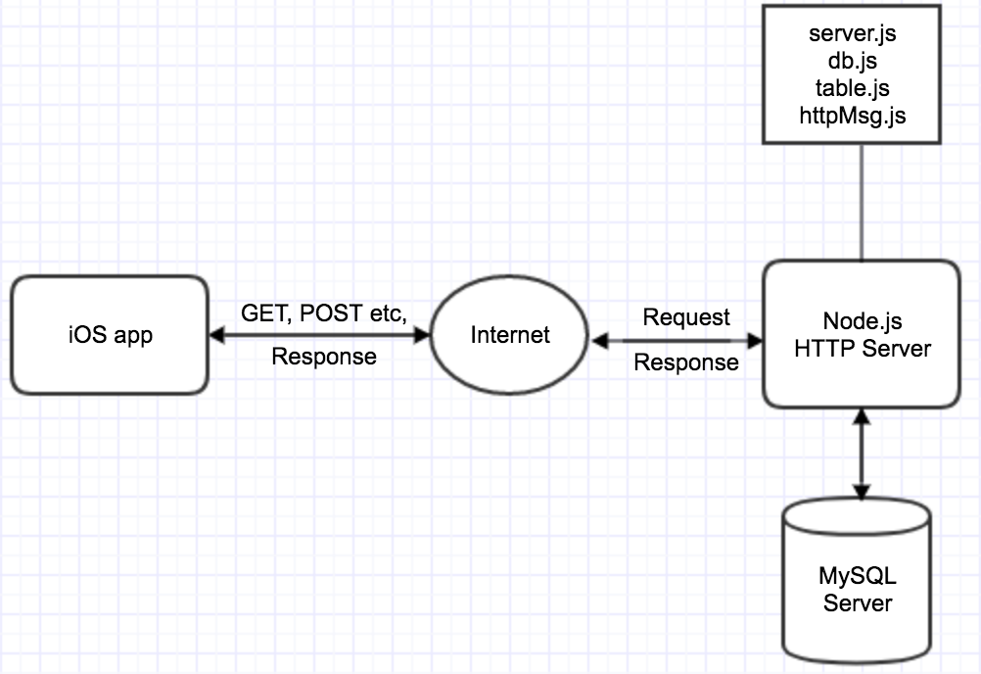
High Level Architecture

Slide 17
Key Issues and Solutions
Thread safety (sending OBD-II PIDs)
Extra data about the car

Slide 18
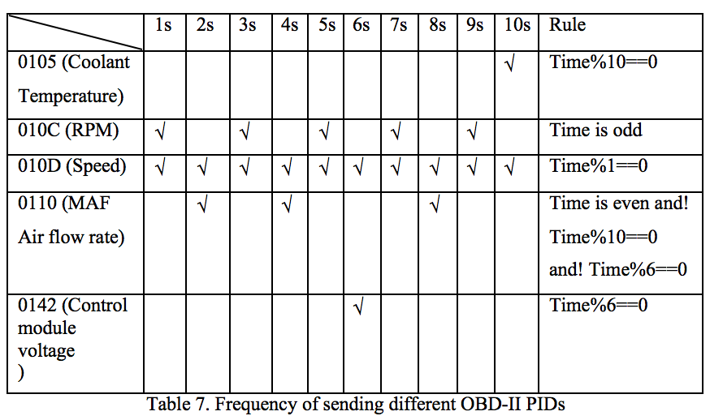
Frequency of Sending Different OBD-II PIDs

Slide 19
Key Values
How distance was calculated
Notes:
Area distance=average speed* time Calculus

Slide 20
Detailed System Design
Database design
User table
Trip table
Relationship between user table and trip table
Password encryption and decryption
Notes:
Password encryption was designed to grantee account safety. When a user had created an account for this application, the password would be encrypted when it was insert into server database table. This technology was supported by MySQL. The encryption method was “AES_Encypty (password, key)”. By using this method, the password in the table would be a messy code and no one could read useful information form that messy code. The key of password worked as an index. The application could only find the password through the key. This project would use unique username as the key of the password.

Slide 21
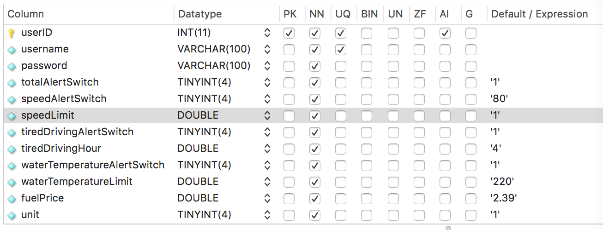
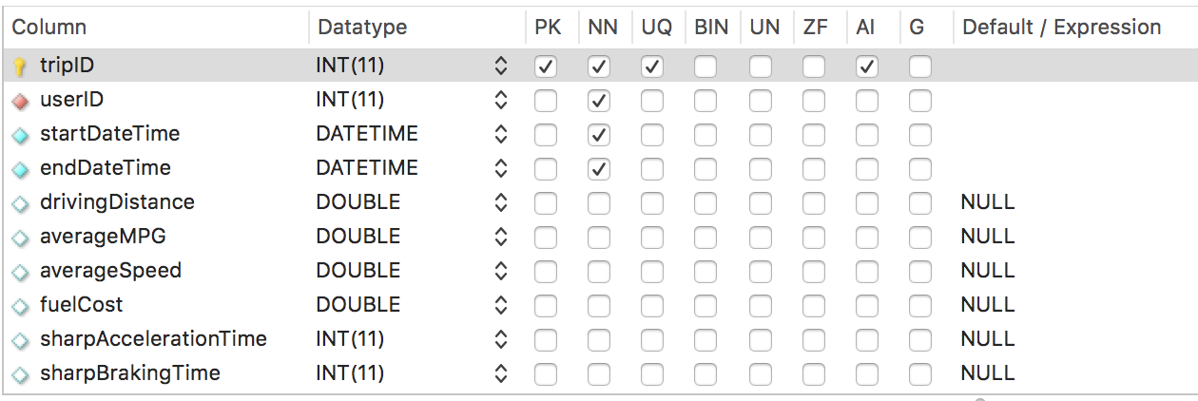

Slide 22
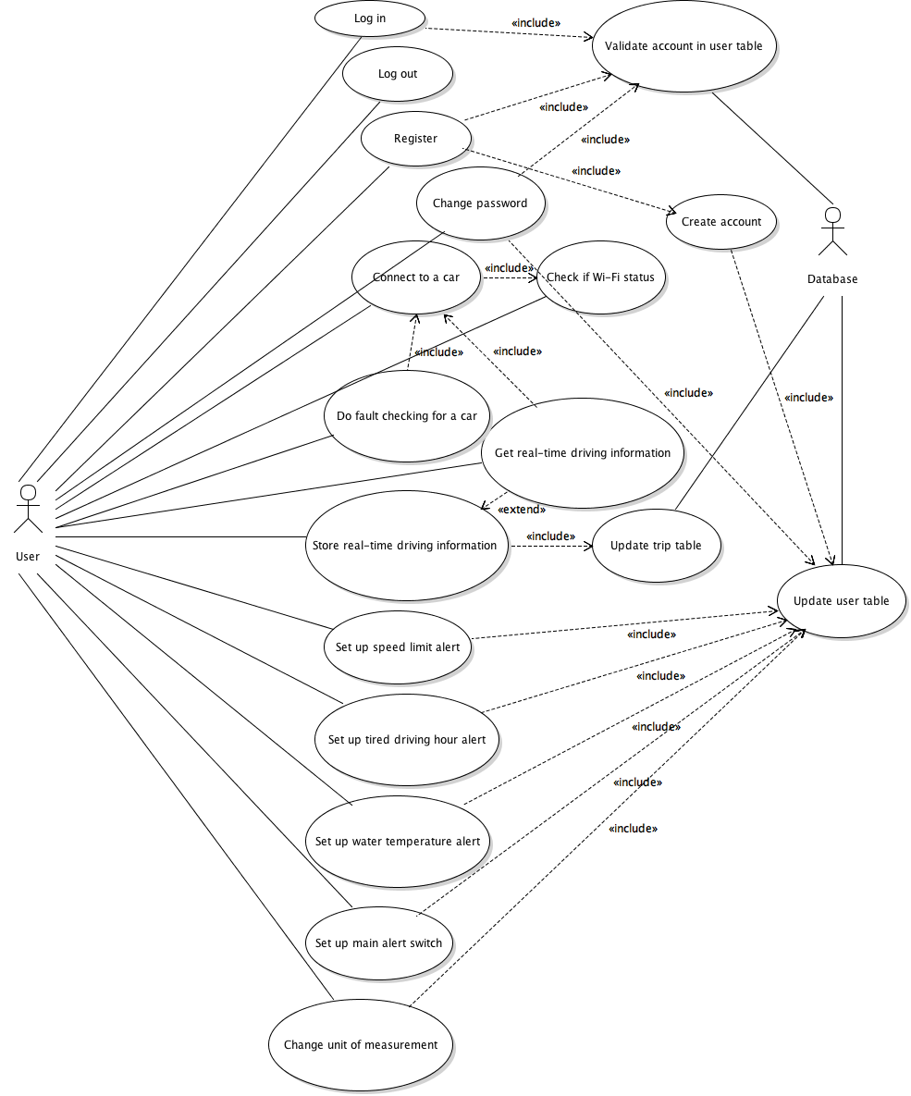
Use Case Diagram

Slide 23
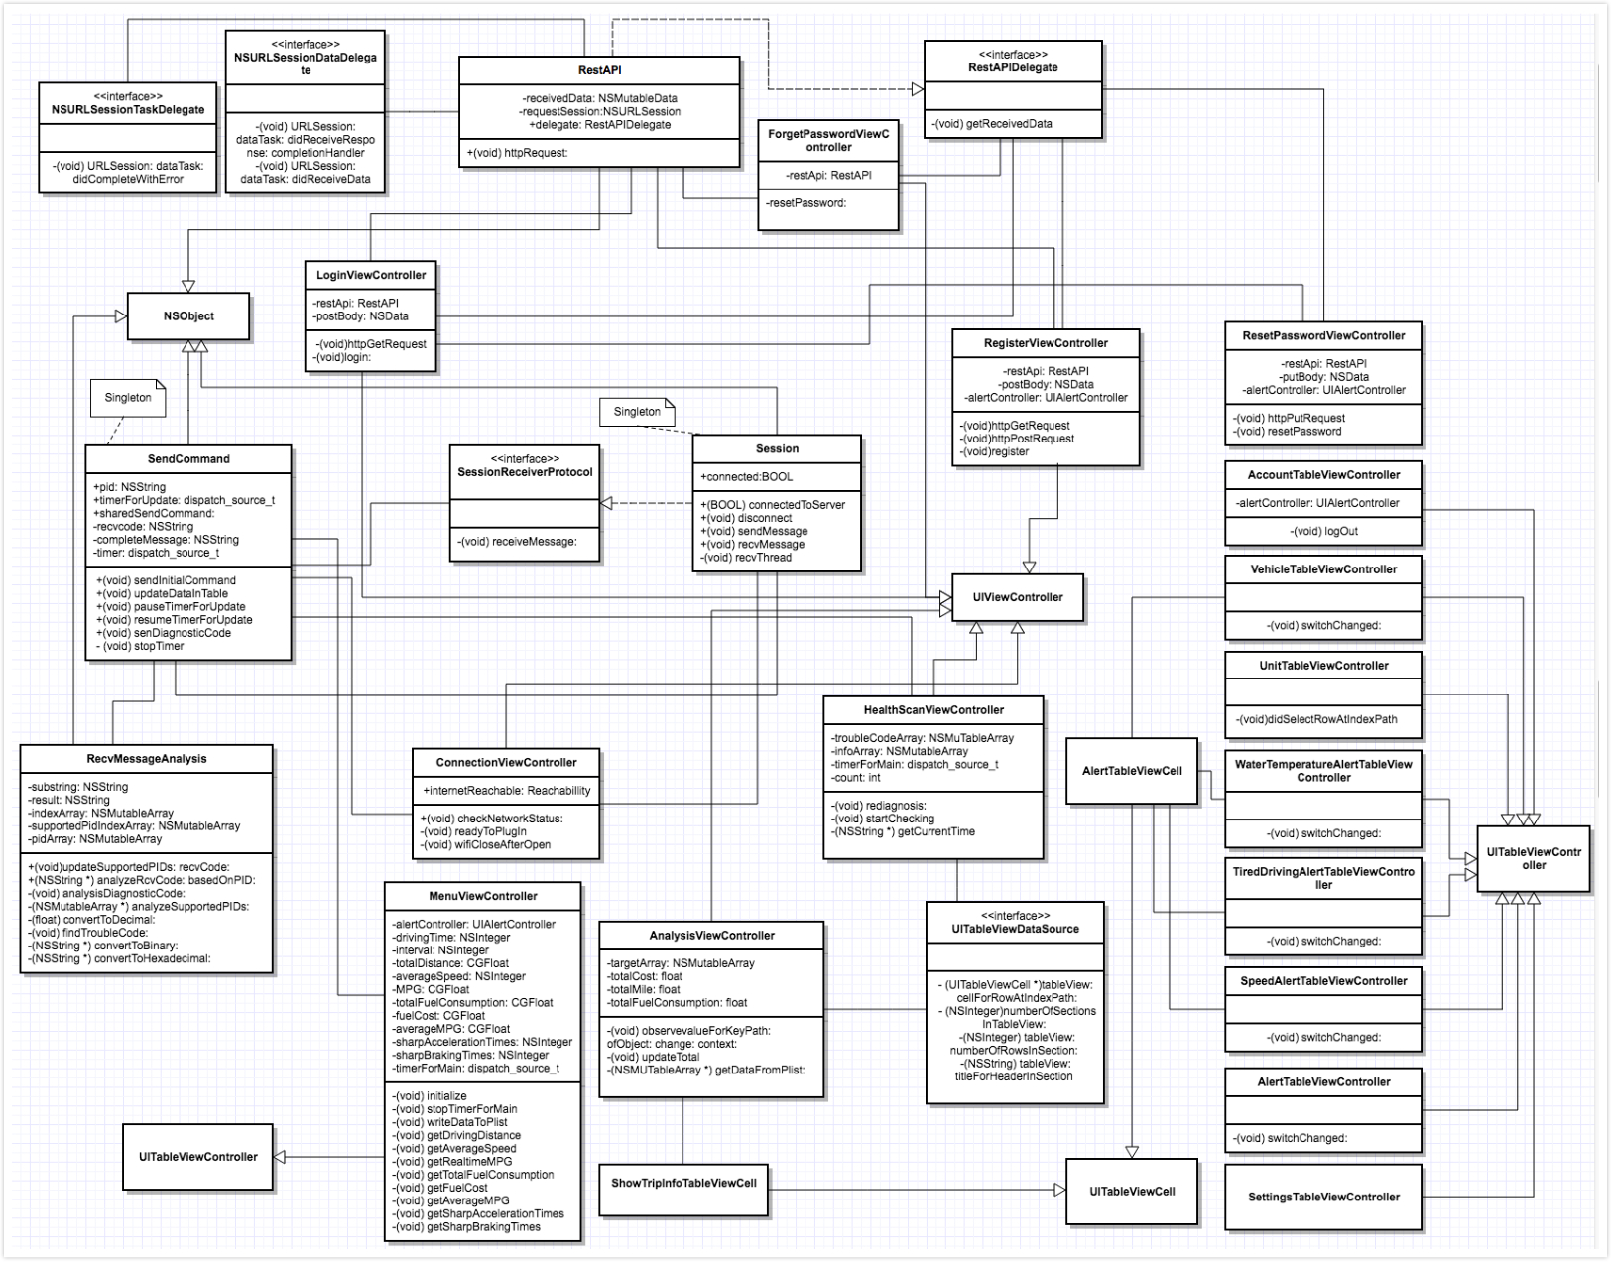
Class Diagram

Slide 24
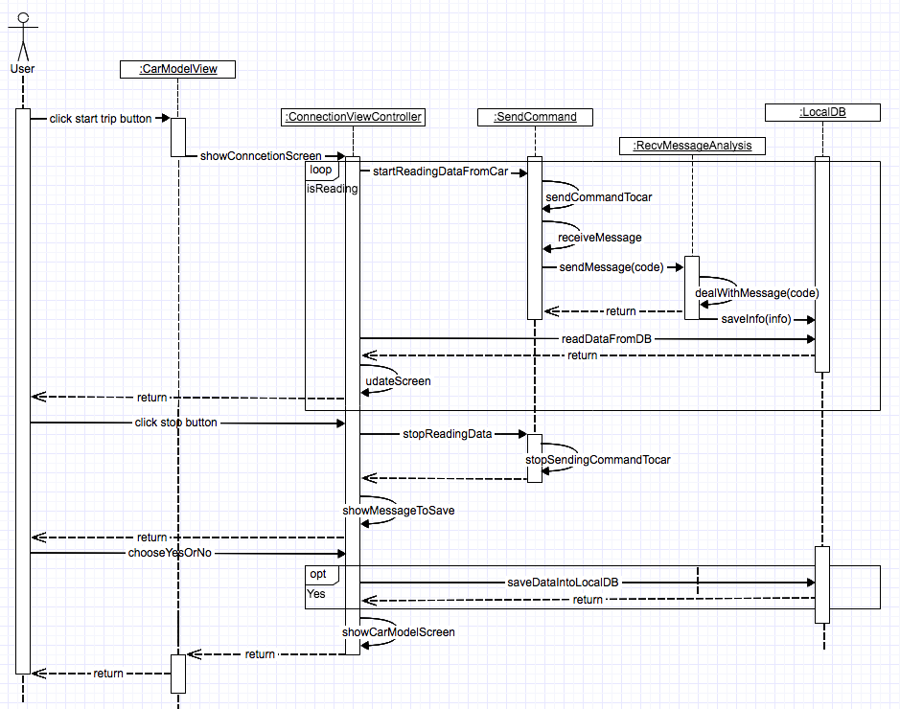
Sequence Diagram

Slide 25
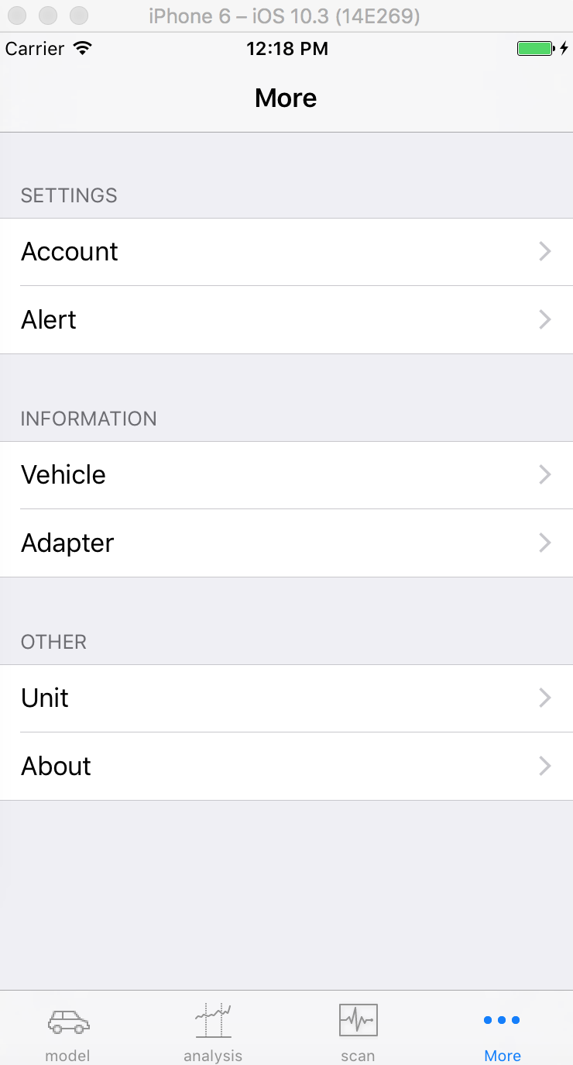
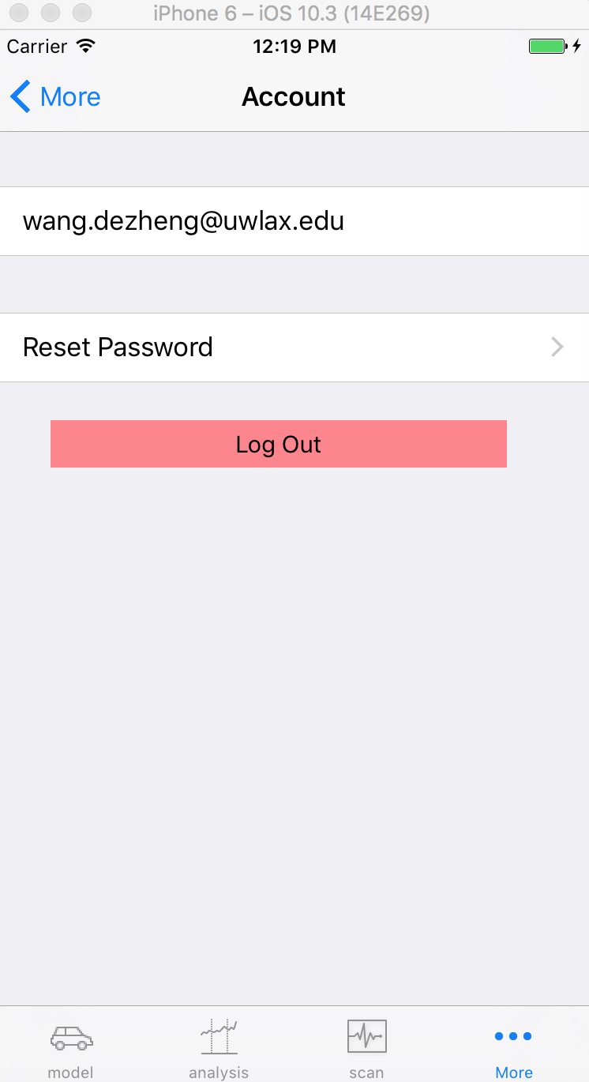
GUI Design
User Interface design
Tab bar
Navigation bar
Notes:
The tab bar usually put navigation icons at the bottom of a screen to fit finger touch. Users could navigate directly to the screen associated with the item. By using tab bar navigation pattern, users could easily have access to all main functionalities without multiple touches; In addition, users could know where they were and what to do when they are using the application.
In general, a navigation appeared between the status bar and an app screen. Users could view the status and application screens without having any troubles. A navigation bar usually had title, back button and control button. Back button was always associated with previous screen and appears on the left side of the bar. Title always showed information of current screen and appears on the middle of the bar. As for control button, it was related to a Cancel or Done button and mainly used to manage users’ actions.

Slide 26
Testing
Testing plan
Server side, Postman
Client side
UI testing in Xcode
Notes:
Compared to other UI testing framework, the major benefit of UI testing in Xcode is that it can record developers’ operations to the system. In the other words, developers can perform all kinds of operations in each user interface to test all kinds of situations and then UI testing will memorize those operations and transfer them into testing codes which can be executed automatically.

Slide 27
Example
Test case # | Scenario | URL | Return value | Status
1 | User table has this account | 138.49.101.87:9000/userSettings /wang.dezheng@uwlax.edu Method: GET | All user information related to username ‘wang.dezheng@uwlax.edu’ | Passed
2 | User table doesn’t have this account | 138.49.101.87:9000/userSettings /wang.dezheng@uwlax.edu Method: GET | [] | Passed

Slide 28
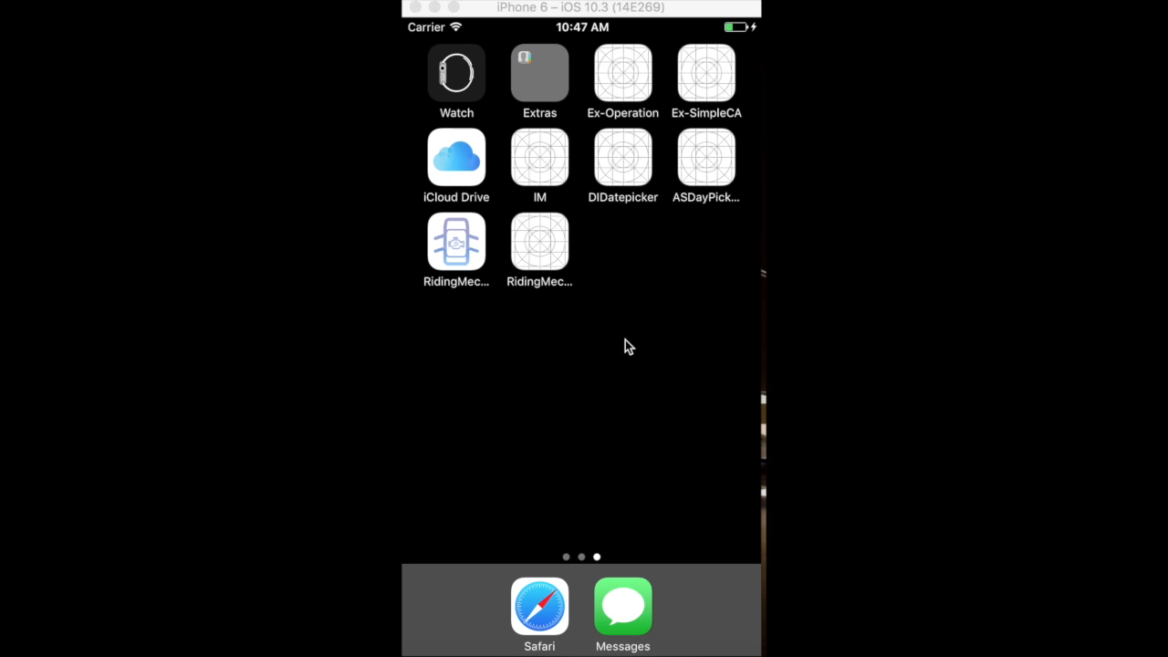

Slide 29
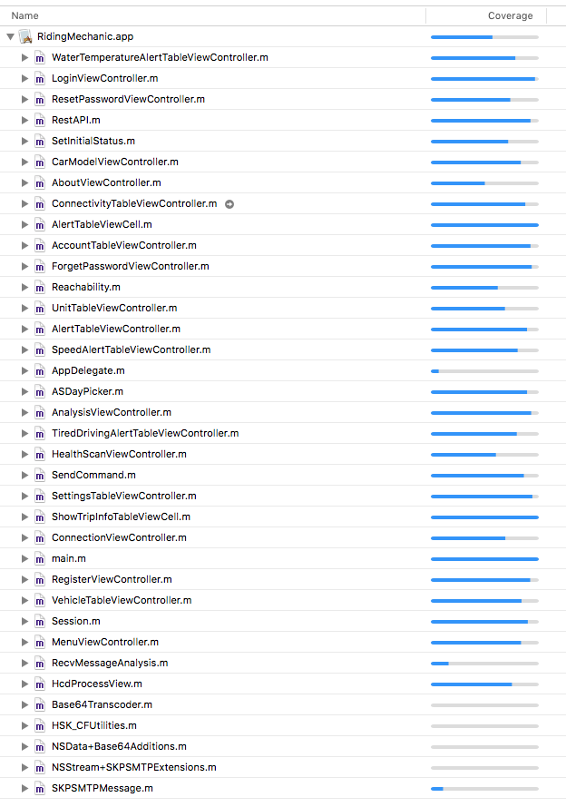
Code Coverage
Notes:
As it indicated in the figure, some classes were not covered. The reason why they were had little testing code coverage was that some classes were external classes or from third-party library which had lots of functions. But only one or two functions would be used for this application among those functions.

Slide 30
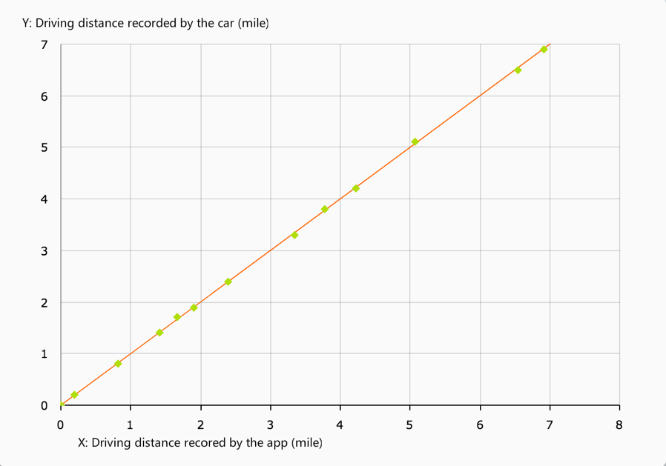
Comparison

Slide 31
Conclusion
Conclusion
Achievement
Defects
Future Work
Notes:
The overriding achievement of this thesis was use of software engineering in mobile application design. It had showed the process of analyzing user requirements, designing system architecture, constructing the whole system, implementation and testing final product.
Although this product had been tested for many times, there were some defects in it. User interfaces did not look very nice and did not have any appropriate message while loading data from server database. The screen did not look very fluent while logging out. Users could not select their own vehicles and find out some manufacture-defined fault codes.
As mentioned above, there existed some weakness in the final product. The first thing of future work was to overcome those shortcomings. More data could be worked out to provide more vehicle information for users. For example, giving total idle time during a route. Because this product only provided universal diagnostic information, some manufacturer-specific codes could not be recognized. The database could gather more information for both universal diagnostic codes and manufacturer-specific codes. In a word, this application still had lots of work to do to become a real product.

Slide 32
Demo
Register, login
Start a trip, read real-time data, record a trip
Set speed alert, start a trip, record a trip
Search trip information
Read diagnostic trouble codes form the car

